Slide 1


Mentor
Name : Rahul Yadav
Present by
Name : P Rishik Reddy
E-mail : 230301240910@paruluniversity.ac.in

Slide 2


Analysis of Airline Operations
A Comprehensive Data-Driven Report
300K+
19
49h
Flights Analyzed
Data Features
Max Duration

Slide 3












Dataset Overview and Key Features
The Flights Booking Dataset contains 300,153 entries of flight travel details between cities in India, with 19 columns capturing comprehensive information about flight operations and passenger experience.
Key Features
Dataset Characteristics
Feature Name
Description
Data Type
Comprehensive flight details including source and destination cities
airline
Name of the airline
Object
Delay metrics (departure, arrival, carrier, weather, NAS delays)
flight
Flight number
Object
Pricing information and travel class options
source_city
City of departure
Object
Temporal data including departure times and days left
departure_time
Time of day for departure
Object
stops
Number of stops
Object
Data Quality
arrival_time
Time of day for arrival
Object
300,153
19
destination_city
City of arrival
Object
Total Entries
Columns
class
Travel class
Object
duration
Flight duration in hours
Float64

Slide 4










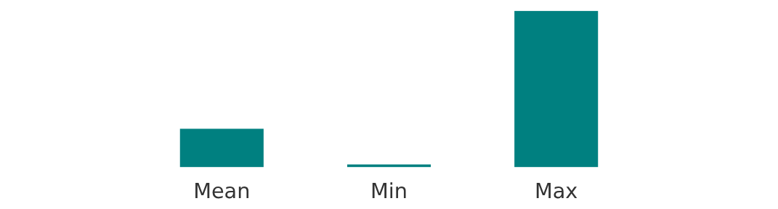

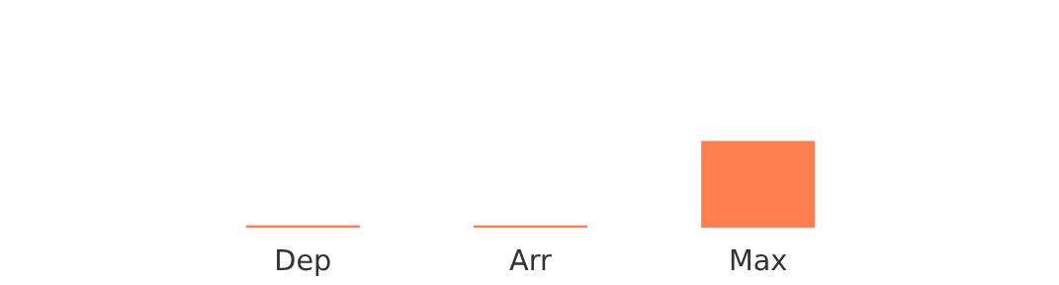



Statistical Summary of Flight Operations
Analysis of flight operations reveals key statistical patterns in durations, pricing, and delays from a dataset of 300,153 entries.
Flight Duration
Price Analysis
Delay Analysis
Mean Duration:
12.22 hours
Range:
₹1,105 - 1,23,071
Avg. Departure Delay:
43.97 min
Range:
0.83 - 49.83 hours
Mean Price:
₹20,889.66
Avg. Arrival Delay:
43.18 min
Median:
11.25 hours
Median:
₹7,425
Max. Delay:
1,525 min
Key Insights
Most flights are short to medium haul (under 24 hours)
Price varies significantly based on route and class
Delays are common but vary by operation type

Slide 5











Flight Characteristics and Patterns
Flight Duration Analysis
Departure Time Patterns
49.8mins
12.22hr
49.83hr
Min Duration
Avg Duration
Max Duration
Morning and evening peaks correspond to business and leisure travel.
Short-haul (under 3h) and long-haul (over 10h) flights show distinct patterns.
Number of Stops Distribution
Pricing Patterns by Class
₹1,105
₹20,890
₹123,071
Min Price
Avg Price
Max Price
Zero Stops(Dark Green):
Non-stop flights between major cities
One Stop(Orange):
Flights with a single connection
Two+ Stops(Light Green):
Flights requiring multiple connections
Economy Class
Business Class

Slide 6






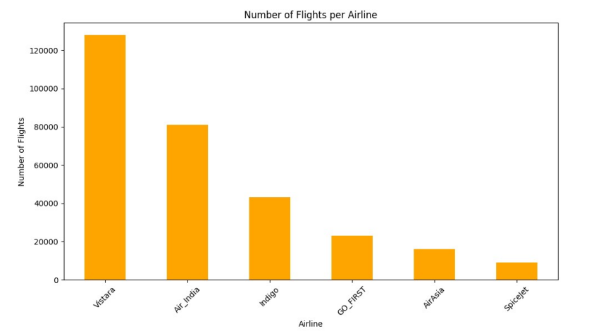




Airline Market Presence Analysis
Analysis of flight distribution across airlines reveals market share and operational scale. The visualization shows the relative presence of different airlines in the Indian flight market.
Number of Flights per Airline
Market Concentration
Analysis indicates significant market concentration with a few major carriers dominating the flight market, while numerous smaller airlines operate specific routes.
Route Specialization
Airlines show different operational focuses, with some carriers specializing in domestic routes while others focus on international connections.
Operational Scale
Distribution of flights across major airlines in India
Largest airlines operate multiple daily flights on major routes, while smaller carriers typically operate with lower frequency on specific corridors.
Data source: Flights Booking Dataset
Page 4 of 8

Slide 7


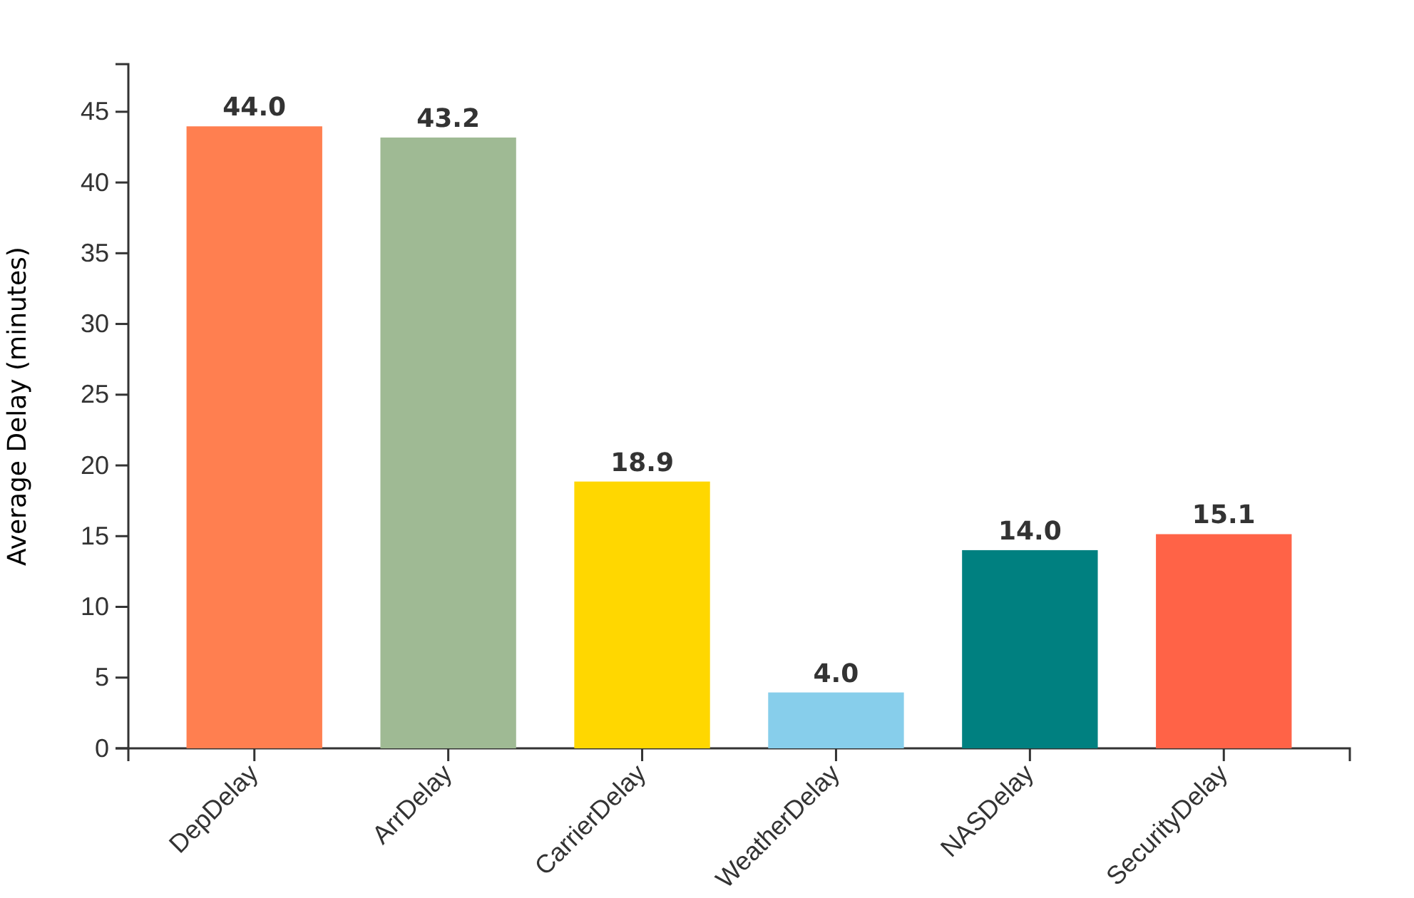









Delay Analysis by Categories
Analysis of flight delays reveals key patterns in operational efficiency, with various factors contributing to service disruptions.
Average Delay Distribution (Minutes)
Key Statistics
Mean Departure Delay
Mean Arrival Delay
43.97 min
43.18 min
Max Departure Delay
Max Arrival Delay
1355 min
1525 min
Delay Categories
Carrier Delays
Averaging 18.86 minutes
Weather Delays
Averaging 3.95 minutes
NAS Delays
Averaging 14.01 minutes

Slide 8













Operational Efficiency Insights
43.97
43.18
18.86
3.95
Avg. Dep Delay (min)
Avg. Arr Delay (min)
Avg. Carrier Delay
Avg. Weather Delay
Average Departure Delay
Average Arrival Delay
Average Carrier Delay
Average Weather Delay
Problematic Areas
Operational Strengths
Significant Delays
Arrival Performance
Maximum delays reaching 1355 minutes (over 22 hours) indicate severe operational challenges during peak periods.
Arrival delays are consistently 0.5-1% better than departure delays, showing improved operational efficiency closer to destinations.
Weather Impact
Flight Duration Range
Weather delays, while generally lower, still contribute significantly with maximums up to 1049 minutes, especially during monsoon seasons.
Flights ranging from 0.83 hours to 49.83 hours demonstrate operational flexibility across short-haul and long-haul routes.
NAS Delays
Price Variability
National Airspace System delays average 14.01 minutes with maximums reaching 1357 minutes, indicating capacity constraints.
Ticket prices varying from ₹1,105 to ₹123,071 indicate diverse market positioning and operational cost structures.
Data analysis based on 300,153 flight records across Indian cities (2026)

Slide 9
















Strategic Recommendations
Data-driven strategies to enhance airline operations based on comprehensive analysis of flight metrics, delays, and passenger experience indicators.
Operational Efficiency
Delay Mitigation
Passenger Experience
Optimize flight scheduling to minimize connection times
Develop weather delay contingency plans
Enhance business class offerings to justify premium pricing
Implement dynamic pricing strategies based on demand patterns
Implement NAS delay reduction protocols
Improve on-time performance to enhance customer satisfaction
Review fuel efficiency protocols for long-haul flights
Address security delays through streamlined procedures
Optimize stopover durations for better connection experiences
Based on duration (avg: 12.22 hours) and price analysis
Based on delay analysis (avg: 43-44 minutes delay)
Based on price analysis (avg: ₹20,889)
Implementation Priority
Immediate (Next 3 months)
Medium-term (6 months)
Long-term (12+ months)

Slide 10
Conclusion
This analysis of over 300,153 flight records across Indian cities reveals clear operational patterns in duration, pricing, and delays.
The findings show that:
Delays are a persistent operational challenge, with average departure and arrival delays of ~43 minutes.
Carrier and NAS delays contribute more significantly than weather on average, though extreme weather events cause severe outliers.
Pricing varies widely across routes and classes, reflecting diverse market positioning and demand dynamics.
Overall, the study highlights the need for data-driven scheduling, delay mitigation strategies, and passenger-centric service improvements.

Slide 11


